Slide 1
Cost & Usage Management on OCI
Pablo Ruiz
Technical Alliance Consultant
Oracle Cloud Infrastructure
Oct 20, 2024
Notes:
Welcome to my presentation on the discovery phase for the Billing Application.
This presentation will focus on the why and what rather than the how of this project.
My goal is to provide a clear rationale of why this app would be a significant value add for our partners and help them in managing and growing their OCI practice.

Slide 2




Usage & Cost Reporting
Four key components to cost and usage management on OCI. Graphical Interface
Governance & Organization Management
Allows creating or linking existing child tenancies to a parent tenancy.
Parent tenancy controls cost, governance and subscription mapping.
.
Cost/Usage Analysis Console
A data dashboard available through the OCI console to analyse cost/usage data.
Child tenancies can see their own cost & usage while Parent can see the whole organization’s .
Use filters and grouping to filter the data and control how it is displayed.
Usage API
The underlying REST API used by the Cost Analysis tool in the console.
Available through all of the OCI SDKs for easy development in the language of your choice:
Java, Python, TypeScript/JavaScript, .NET, Go, Ruby
Cost & Usage Reports
Reports including the raw data as a CSV file and are the ground truth.
Contains a line item per resource per hour.
Generated every six hours.

Slide 3
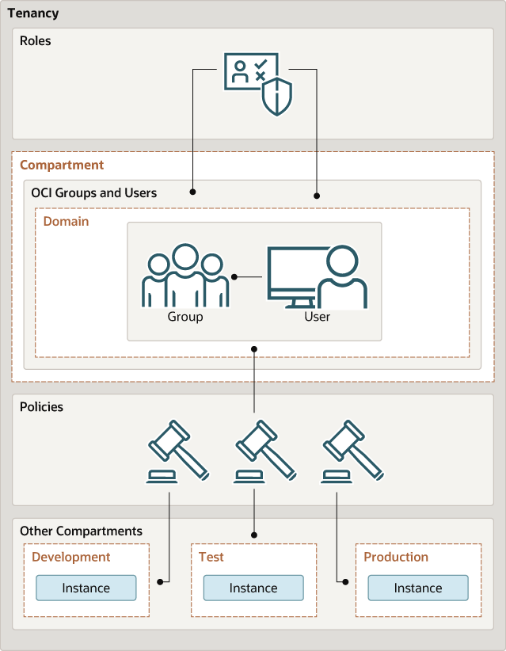
What IAM Policies do you need?
Application Cloud Architecture
IAM Policies control user authorization to cloud resources either through the console or APIs.
Cost/Usage Analysis
Use:
Allow group <group_name> to read usage-report in tenancy
Save Reports:
Allow group <group_name> to manage usage-report in tenancy
Cost & Usage Reports
define tenancy usage-report as ocid1.tenancy.oc1..aaaaaaaaned4fkpkisbwjlr56u7cj63lf3wffbilvqknstgtvzub7vhqkggq
endorse group <group> to read objects in tenancy usage-report
Figure 1. Users, groups, policies structure.

Slide 4
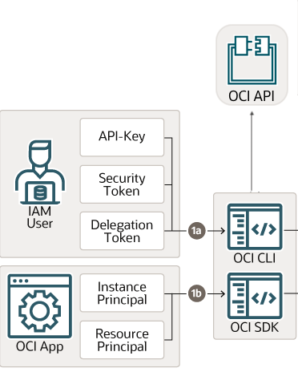
API Authentication
OCI SDKs supports multiple authentication methods
API key-based authentication
Uses a configuration file stored on the local disk containing details such as user OCID, tenancy OCID, region, and key path.
Session token-based authentication
Uses a temporary session token usually obtained through the console or CLI.
Instance principal
Authorize an instance running in OCI to call the OCI API without the need to configure user credentials.
Resource principal
Same as Instance Principal but intended for resources that are not instance such as server-less functions.
Figure 2. API authentication process.
Notes:
of

Slide 5
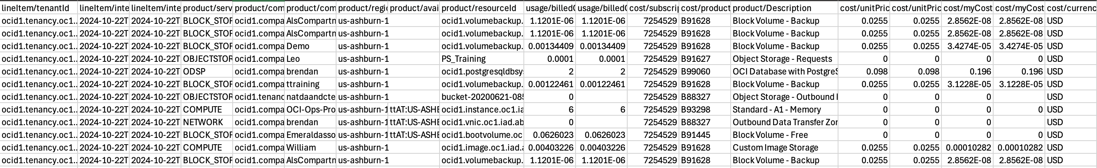
Cost & Usage Reports
Ground truth cost & usage periodic data dumps
Delivered in an Oracle manage storage bucket in your tenancy every 6 hours.
One line item per resource per hour.
Usage Report: consumption in that service’s consumption metric.
Cost Report: Final cost to customer after rate card discounts.
Figure 3. Excerpt from a cost report.

Slide 6
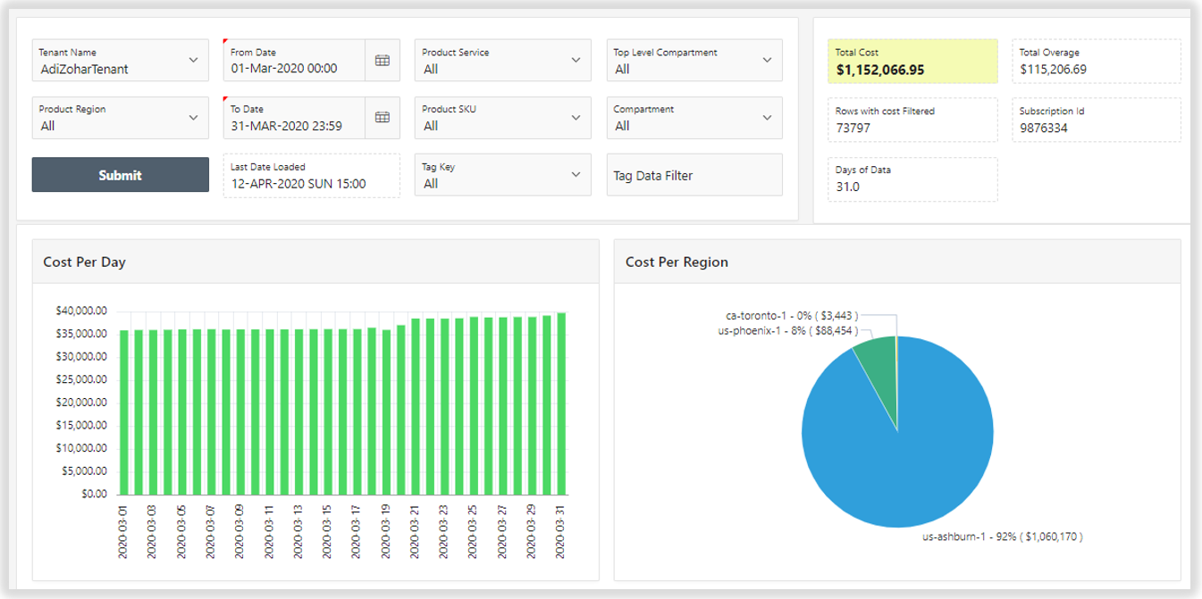
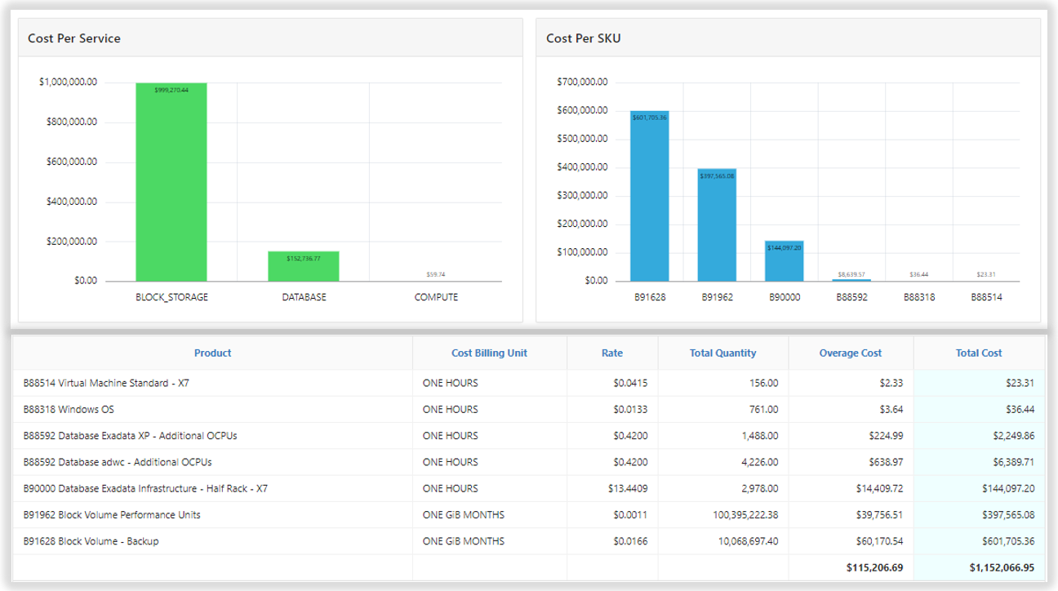
Usage-to-ADW Application
Sample application to load cost & usage data into an oracle database
Uses OCI API to automatically pull the cost & usage reports from object storage.
Can aggregate data from multiple tenancies whether linked through the Organizations Service or not.
Displays the data in a data dashboard built using Oracle APEX.
Retains granularity of cost & usage reports while offering the accessibility similar to the Cost Analysis tool.
Figure 4. Usage2ADW Cost Dashboards.

Slide 7
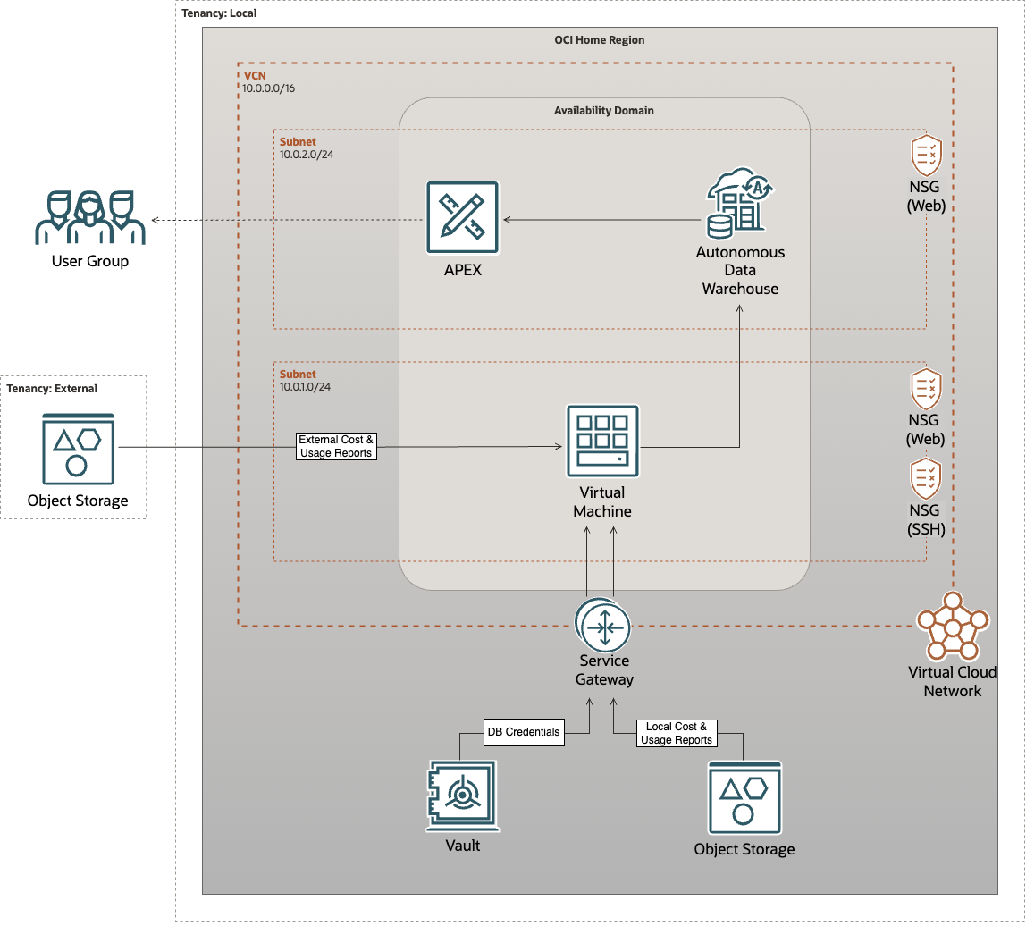
Usage-to-ADW Application
Architecture
Figure 5. Usage2ADW architecture.

Slide 8
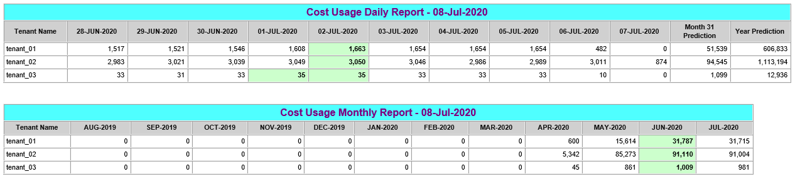
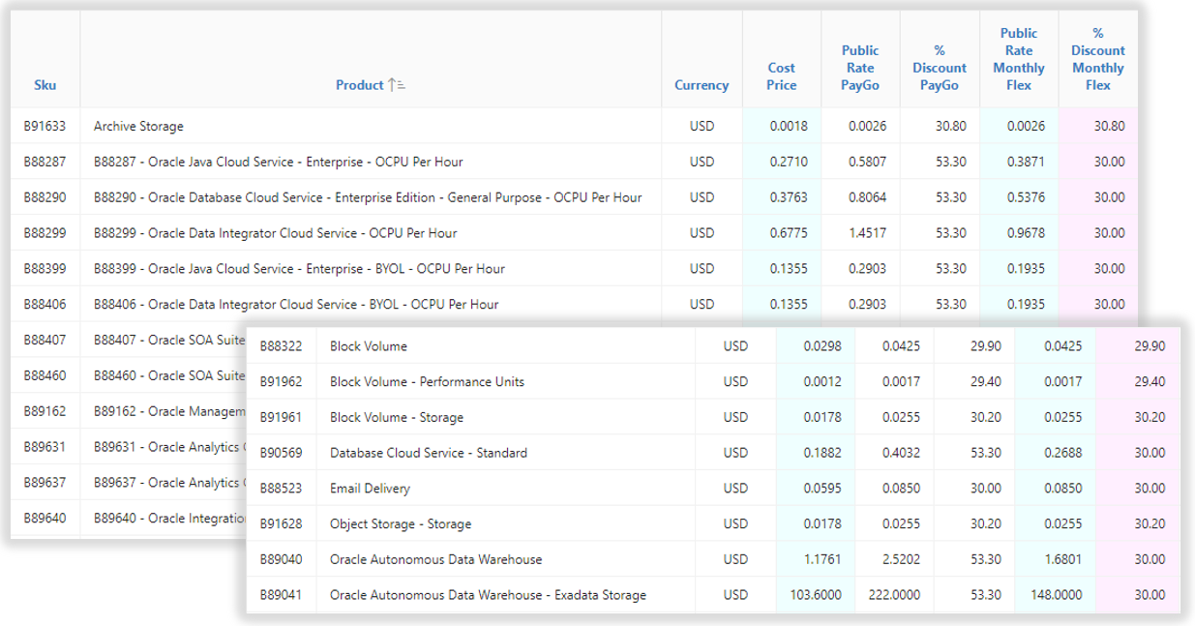
Usage-to-ADW Application
Optional automated email report delivery and rate card discount percentage calculation
Schedule Email Report:
A daily email report with current costs for each included tenancy and future predictions can be enabled.
Daily report must be configured within the VM. Learn more at: Github how-to guide.
Rate Card:
A rate card can be enabled to automatically show the current rate card discounts for the tenancy as reported by the OCI API.
Figure 5. APEX dashboard daily email report.
Figure 6. APEX dashboard rate card.

Slide 9
References and Documentation Resources
Cost Analysis OCI Docs:
https://docs.oracle.com/en-us/iaas/Content/Billing/Concepts/costanalysisoverview.htm
Cost & Usage Reports OCI Docs:
https://docs.oracle.com/en-us/iaas/Content/Billing/Concepts/usagereportsoverview.htm
OCI API Endpoints:
https://docs.oracle.com/en-us/iaas/api/
OCI API Postman Documentation:
https://www.postman.com/oracledevs/oracle-cloud-infrastructure-rest-apis/overview
OCI API Authentication:
https://docs.oracle.com/en-us/iaas/Content/API/Concepts/sdk_authentication_methods.htm
OCI SDK Guides:
https://docs.oracle.com/en-us/iaas/Content/API/Concepts/sdks.htm
OCI Python SDK Docs:
https://docs.oracle.com/en-us/iaas/tools/python/2.136.0/index.html
Usage2Adw Application Repository:
https://github.com/oracle-samples/usage-reports-to-adw

Slide 10
Thank you

